Slide 1


ESP32 CAM Blynk Multiple Camera Surveillance
IoT Presentation
Subject Code: KEC 752
Subject Name: Mini Project
Branch- ECE
Submitted to : Ms. Tania Gupta
By Kushagra Punia
2019b311177

Slide 2
Table of Contents
IoT
Equipment used in this project
IoT Certification Programme
Outcomes

Slide 3
Equipment And Software Used
ESP32 Cam Modules
Breadboard
FTDI Module
Jumper Wires
5V power Supply
Arduino IDE

Slide 4
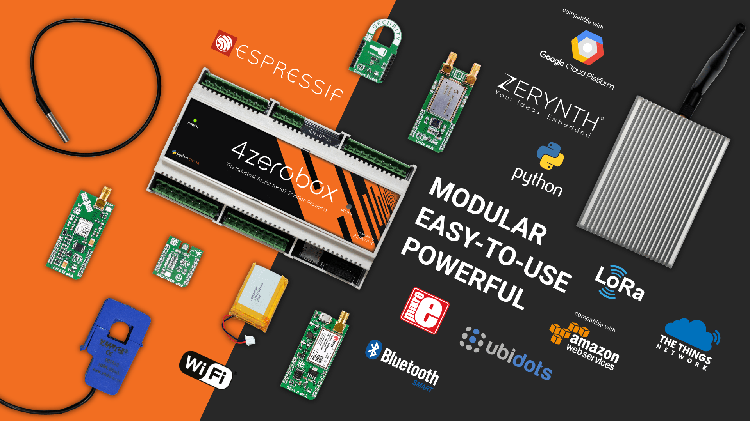
IoT (Internet of Things)
A system of interrelated computing devices, mechanical and digital machines, objects, animals or people that are provided with unique identifiers and the ability to transfer data over a network without requiring human-to-human or human-to-computer interaction
Concept of taking all the physical places and things in the world and connecting them to the internet.

Slide 5
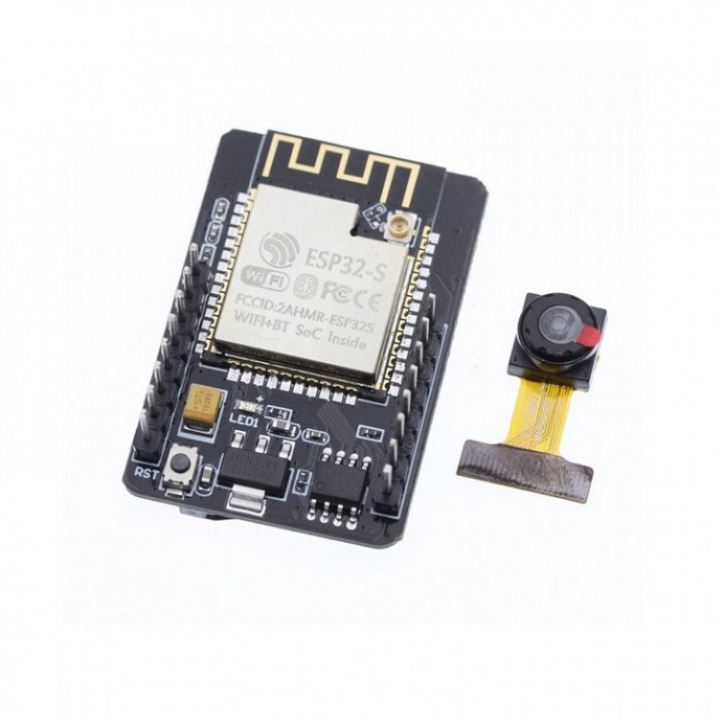
ESP32 Cam Module
OV2640 Camera Module 2MP
Built-in flash lamp
Low power 32-bit CPU
Built-in 520 KB SRAM, external 4MPSRAM.
Power Supply: 5V via pin header
Wireless Module: ESP32-S WiFi 802.11 b/g/n + Bluetooth 4.2 LE module with PCB antenna, u.FL connector, 32Mbit SPI flash, 4MBit PSRAM.

Slide 6
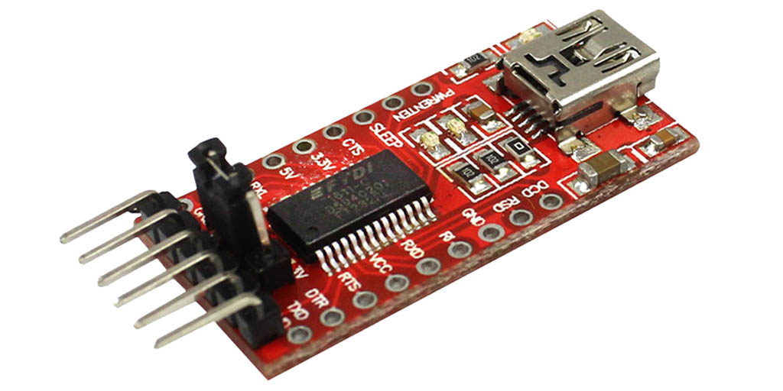
FTDI Module
The FTDI USB to TTL serial converter module is a UART board used for TTL serial communication
The more commonly used pins (RX, TX, VCC and GND) are connected to the corresponding pins of the microcontroller (RX -> TX and TX -> RX).
On-board LEDs: power on, Rx, Tx transmission, working status
Working voltage: 5V DC
Ports: Micro-B USB

Slide 7

Blynk IoT Platform
Blynk is a new platform that allows you to quickly build interfaces for controlling and monitoring your hardware projects from your iOS and Android device.
After downloading the Blynk app, you can create a project dashboard and arrange buttons, sliders, graphs, and other widgets onto the screen.

Slide 8
Project Working
Use of Blynk mobile app, enabled us to make widgets, buttons required for operation of our module
With use of jumper wires and power supply, we made circuits required to upload code into the modules
We wrote the code of the operation required using some relevant libraries.

Slide 9
Outcomes
We learnt Entrepreneurship concepts like Idea validation, Business Canva & Pitching etc.
Learnt about different IoT devices such as Arduino Uno, and ESP32 Dev Module. Also, some detailed information about sensors like HDT, IR etc. OLED Display Along with data transfer from these sensors to IoT Platforms like ThingSpeak.
Different mindset to work with in Startups

Slide 10
Thank You

